Slide 1

AI in College Sports
Navigating the New Economics of the NCAA
Jared Curran
RESECON 490AI - Al in Economics
December 9th, 2025
Jared Curran
RESECON 490A — Al in Economics
November 18, 2025

Slide 2

Started With a Question on the Golf Course
I saw the complexity of NCAA NIL. But I realized the real story wasn't just about Rules it was about the massive, evolving business behind them.
G
NotebookLM

Slide 3



An Industry at a Crossroads: A Mature Core with Volatile Growth Edges
The Mature Core
Multi-Billion Dollar Media Deals
The Big Ten Conference's media deal is valued at over $7 billion, locking in revenue streams and signaling a mature market.
The Growth Engine
The Rise of Women's Sports
The Disruption
The New NIL Market
The 2020 Women's Basketball Championship drew a record 18.9 million viewers, transforming a perceived cost center into a growth engine.
Projected to hit $1.67 billion in 2024-25, the NIL market is a new, rapidly growing layer in the athletics ecosystem.
G
NotebookLM

Slide 4


In the New NIL Market, Is Performance Everything?
On3 NIL Valuation (Millions of USD
7
X Arch
6
High brand value, low initial production.
NIL valuation is a complex mix of on- field performance, campus size, and the intangible power of brand.
Shedeur X
5
4
X LaNorris
3
Elite performance, but lower valuation than pure brand icons.
2
X Jalen
1500 2000 2500 3000
Most Recent Full-Season Passing Yards
1000
3500
4000
This pattern shows NIL is a hybrid of a labor market (performance matters) and an attention market (brand can dominate).

Slide 5
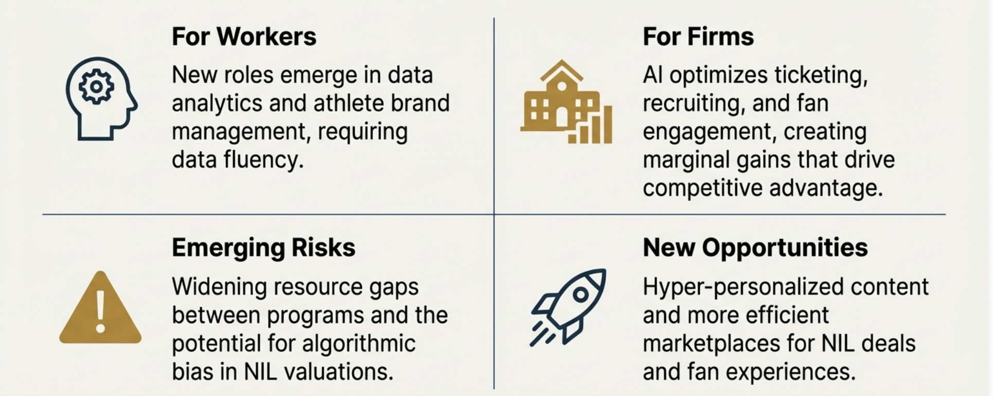
How AI is Reshaping the Game, On and Off the Field
G NotebookLM

Slide 6
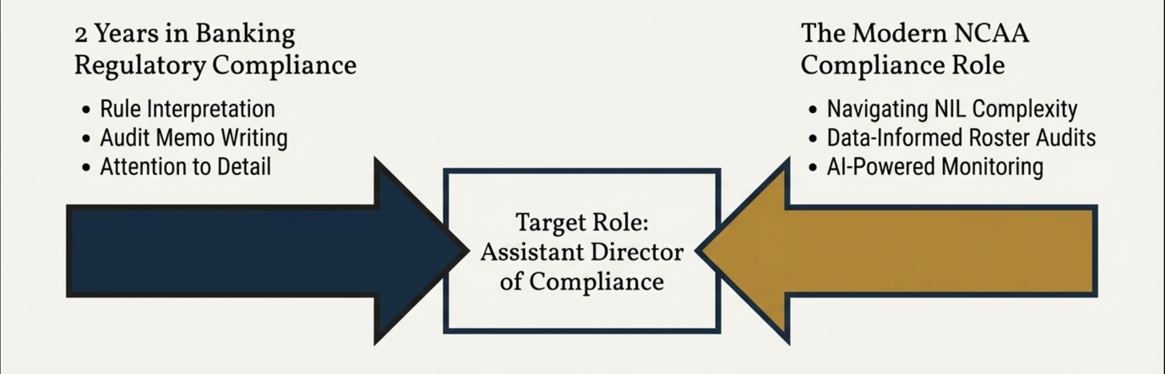
How My Experience Meets the Industry Future
G
NotebookLM

Slide 7
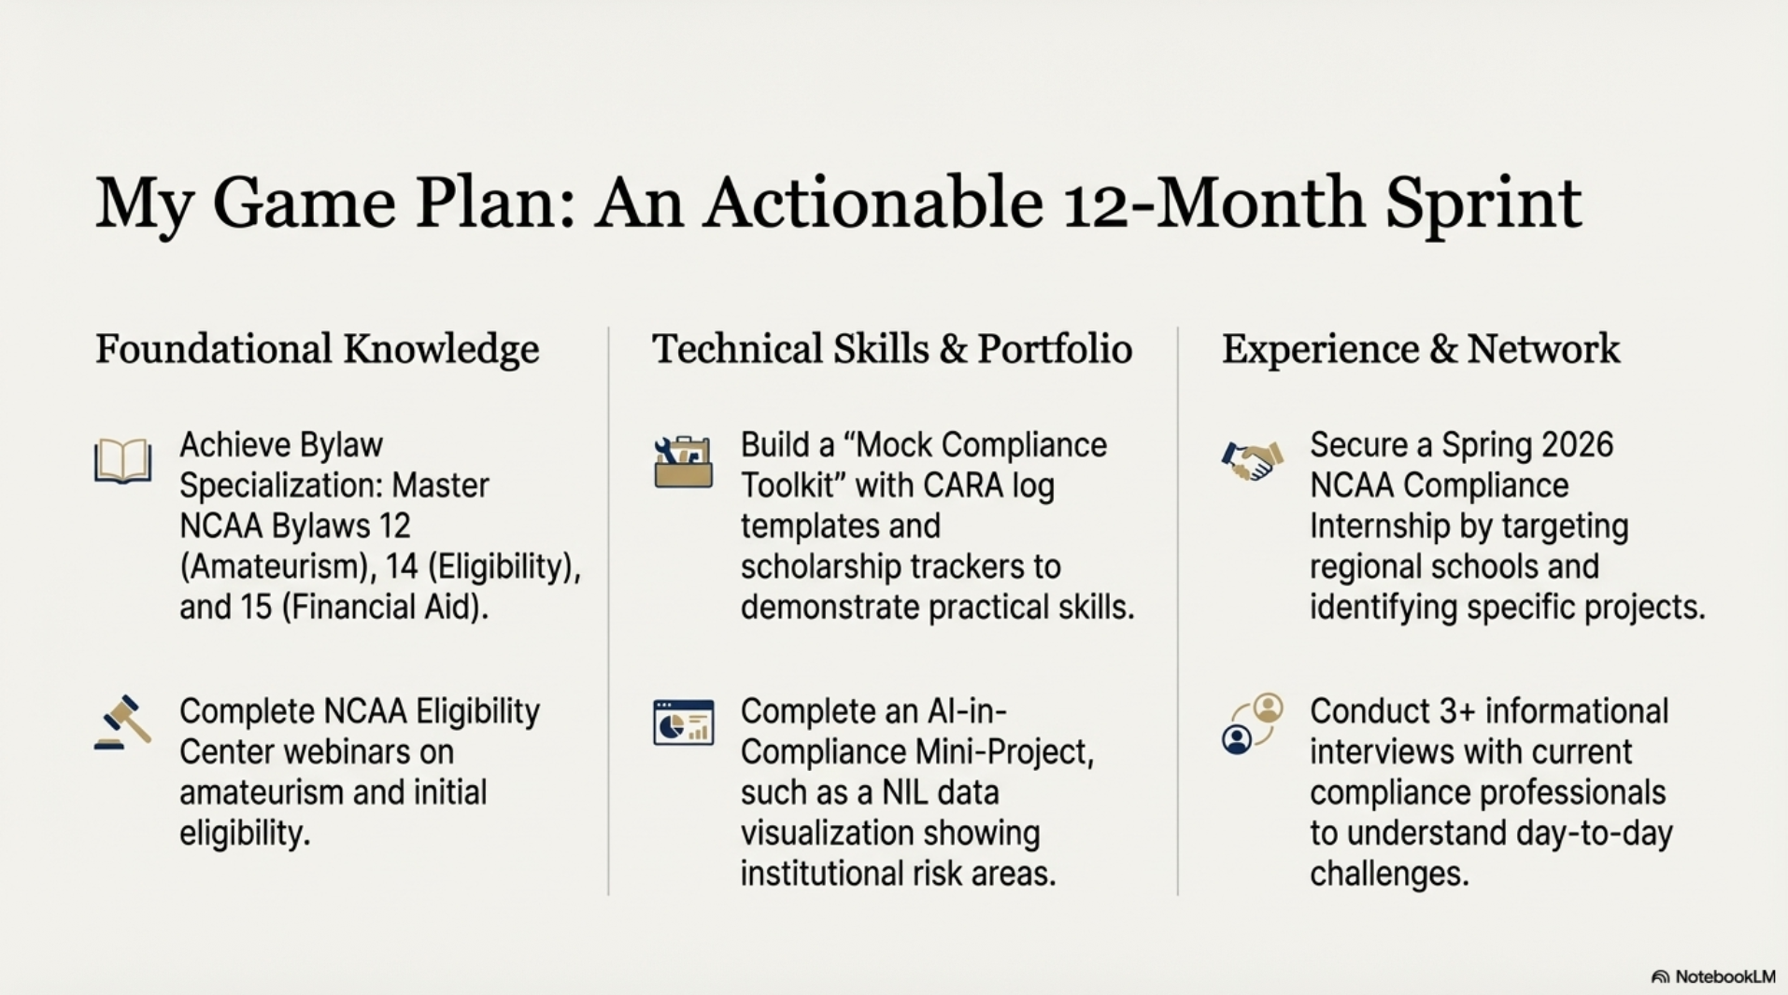

Slide 8
What This Project Taught Me & My AI Use
A Clearer Career Path
This project confirmed my interest in compliance and, more importantly,
revealed the new skills required to succeed. The future of the role is
analytical, and that excites me.
New Economic View of NCAA
I now see NCAA athletics as a two-sided market where athlete brands
are becoming powerful micro-economies, requiring a multivariable
approach to valuation.
A Constructive AI Base
”Start by starting”; AI gave me a useful base which made all processes less of a task.
G NotebookLM

